Slide 1
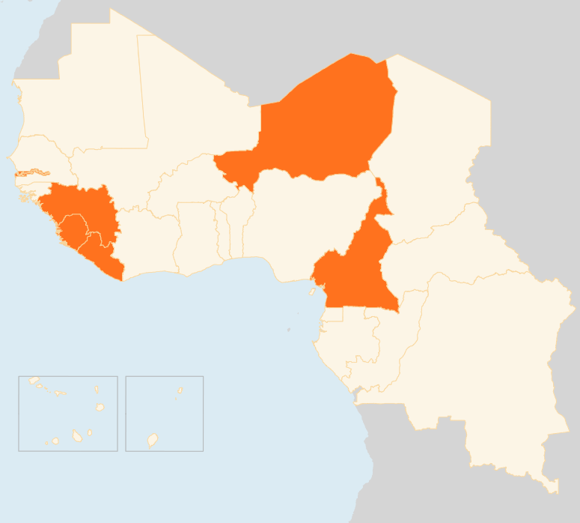

14 - 20 April 2015
CAMEROON
19 KILLED IN BOKO HARAM ATTACK
At least 19 people were killed when Boko Haram gunmen raided Bia village in Cameroon’s Far North Region on the night of 16 April. Many of the victims were reportedly beheaded during the attack on the village located on the shores of Lake Chad. The insurgents have carried out several attacks on Cameroonian territory. Such cross-border raids prompted Nigeria’s neighbours earlier this year to revamp a regional counter-insurgency force that has driven Boko Haram out of several towns and villages in north-eastern Nigeria.
GUINEA
3 DIE IN OPPOSITION PROTESTS
Three people were killed and 50 others wounded in the 13 - 14 April violent opposition protests. The opposition wants local elections to be held before the October presidential polls. The protesters, who are due to march again on the headquarters of Guinea’s national electoral commission on 20 April, claim that the electoral timetable has been pushed through without consultation and gives the ruling party an unfair advantage. The protests come amid the Ebola outbreak that is currently concentrated on the country’s western region.
NIGER
75 KILLED IN MENINGITIS OUTBREAK
As of 13 April, a meningitis outbreak that erupted in January had killed 75 people, mainly in the capital Niamey, according to the health minister. Almost 700 people have been infected by the disease that has been reported in all of Niger’s regions except in the south-eastern Diffa Region. A vaccination campaign has been launched to curb the outbreak that lastly erupted in 2011.
SIERRA LEONE
SCHOOLS REOPEN AFTER NINE MONTHS
Schools across the country reopened on 14 April, with some 1.8 million students expected to resume learning after nine months of closure due to the Ebola epidemic that has so far killed 3,857 people. Preparation to ensure safety had been put in place, with teachers trained and hygiene kits distributed to all schools.
REGIONAL / EBOLA VIRUS DISEASE
SLIGHT INCREASE IN CASES
A total of 37 cases were reported in the week leading up to 12 April, seven more than the previous week. All the infections were in Guinea and Sierra Leone. Liberia has not reported any infections since 27 March. Nine confirmed Ebola cases were recorded in Sierra Leone, the same as the week before, while Guinea reported 28 cases. In total, 25,791 confirmed, probable and suspected cases and 10,689 deaths have been reported in the three countries.
GUINEA
NIGER
3
DIE IN OPPOSITION PROTESTS
75
KILLED IN MENINGITIS OUTBREAK
CAMEROON
SIERRA LEONE
19
KILLED IN INSURGENT RAID
REGIONAL / EVD
SCHOOLS REOPEN AFTER NINE MONTHS
37
CASES IN GUINEA AND SIERRA LEONE
Creation date: 21 April 2014
Map data sources: UNCS, DevInfo, OCHA.
The boundaries and names shown and the designations used on this map do not imply official endorsement or acceptance by the United Nations

